Slide 1






SALAHUDDIN ASSOCIATES
SALAHUDDIN
ASSOCIATES
FIRM PROFILE
www.salahuddinassociates.com

Slide 2



SALAHUDDIN ASSOCIATES
WELCOME TO OUR FIRM
At Salahuddin Associates, we bring together deep expertise and practical understanding to deliver solutions defined by precision, efficiency, and long-term value.
CONTINUE

Slide 3

SALAHUDDIN ASSOCIATES
ABOUT THE FIRM
Salahuddin Associates is a premier professional services firm in Bangladesh, delivering integrated solutions in Taxation, VAT, Corporate Affairs, and Accounting Outsourcing.
Since its establishment in 2013, the firm has built a strong reputation for providing high-quality, reliable, and cost-effective services to a diverse client base, including local enterprises, multinational corporations, startups, and foreign investors.
We combine Big Four–level expertise with deep local regulatory knowledge, enabling our clients to operate efficiently, remain compliant, and achieve sustainable growth.

Slide 4
SALAHUDDIN ASSOCIATES
OUR VISION
To be recognized as a leading professional services firm in Bangladesh, known for excellence, integrity, and delivering world-class advisory and compliance solutions.

Slide 5

SALAHUDDIN ASSOCIATES
OUR MISSION
To provide strategic, accurate, and timely services that empower businesses to navigate regulatory complexities and maximize value.
BUSINESS GROWTH

Slide 6

SALAHUDDIN ASSOCIATES
OUR VALUE PROPOSITION
At Salahuddin Associates, we differentiate ourselves through a unique combination of:
  Expertise – Led by ex–Big Four professionals with extensive industry experience
  Cost Efficiency – Premium-quality services at highly competitive pricing
  Speed & Responsiveness – Timely execution and proactive client support
  Strong Network & Connections – Effective handling of regulatory and compliance matters
  End-to-End Solutions – A single platform for all tax, VAT, corporate, and accounting needs

Slide 7
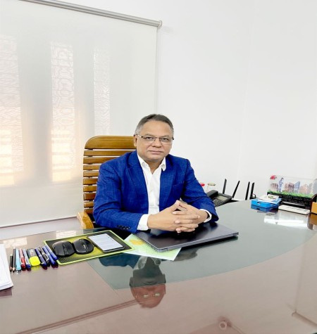
SALAHUDDIN ASSOCIATES
LEADERSHIP
The firm is led by Mr. Salah Uddin, a highly accomplished tax professional with over 35 years of experience in taxation and advisory services.
He previously served as a Senior Manager – Taxation & Advisory at KPMG Bangladesh (Rahman Rahman Huq) for 17 years, one of the country’s leading professional service firms.
His extensive experience includes advising multinational corporations and large local enterprises across sectors such as:
  Telecommunications
  Manufacturing
  Banking & Financial Services
  Energy & Power
  Real Estate
  Ready-Made Garments (RMG)
  Hospitality and Service

Slide 8
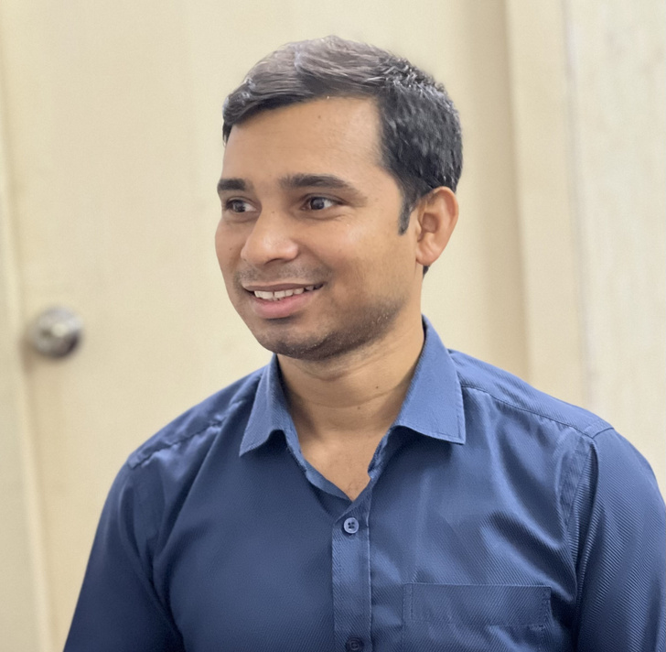
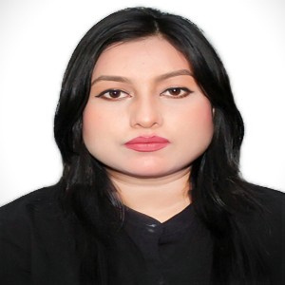
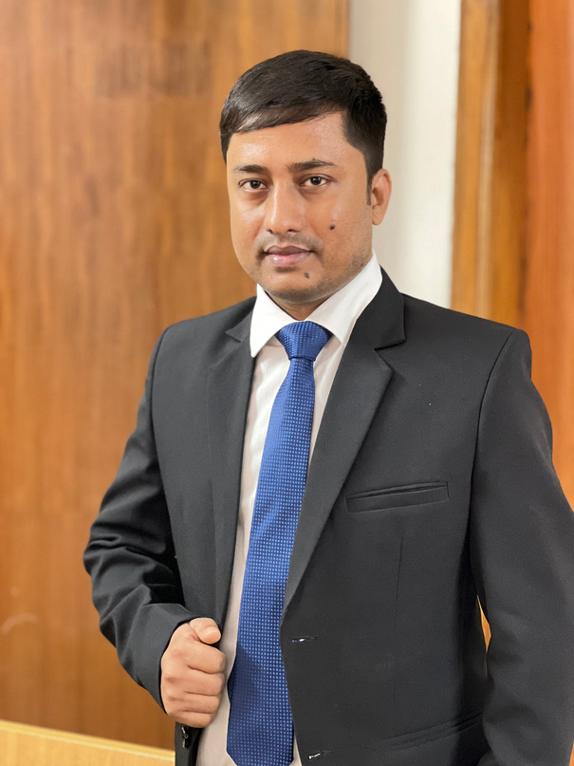
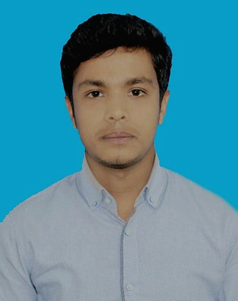
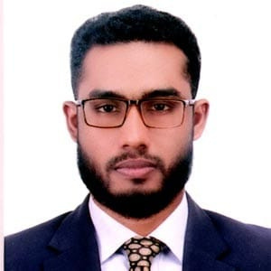
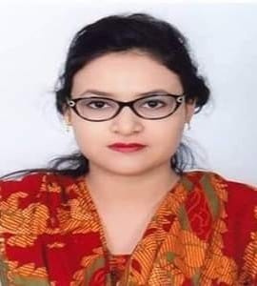
SALAHUDDIN ASSOCIATES
OUR COMPANY PROFESSIONAL TEAM
SYFUL ISLAM
FAHMIDA CHAITY
Senior Manager
IKLASH UDDIN
Assistant Manager
Supervisor
SAIDUL ISLAM
SHAKIL AHMMED
TANZEEM TRINA
Assistant Supervisor
Assistant Supervisor
Supervisor

Slide 9
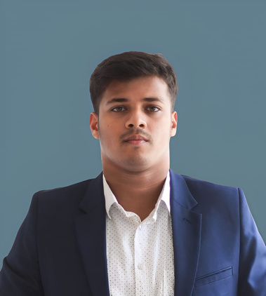
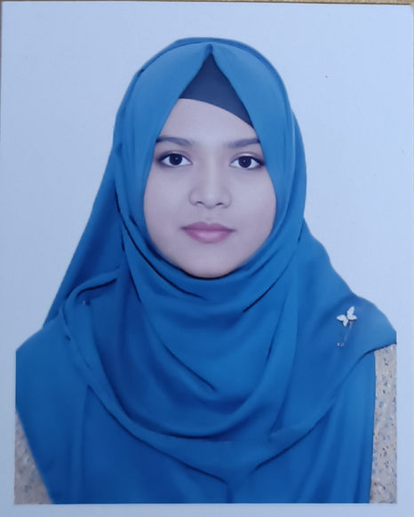
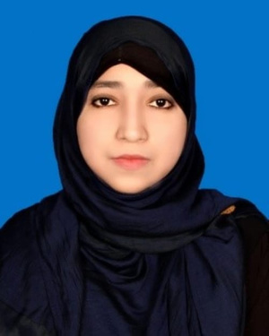
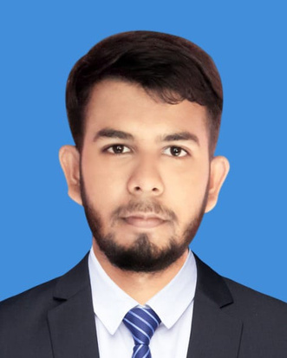
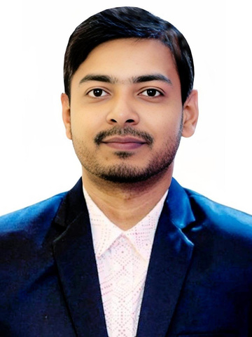
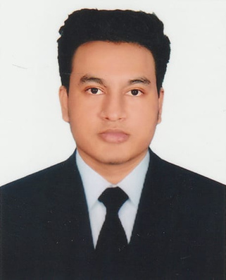
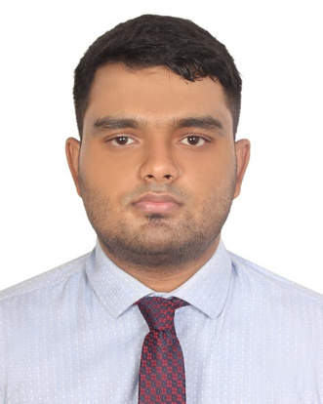
SALAHUDDIN ASSOCIATES
SYFUL ISLAM
Senior Manager
OUR COMPANY PROFESSIONAL TEAM
SHOHANUR RAHMAN
LUBNA MAHZABIN
SABRINA JAHAN
ASHRAFUL ISLAM
Senior Executive
Executive
Executive
Executive
SREEZON DATTA
KAZI RIYAD HOSSAIN
ADIB MAHMUD
Executive
Executive
Executive

Slide 10
SALAHUDDIN ASSOCIATES
OUR COMPANY PREMIUM SERVICE
Tax Advisory & Compliance
VAT Advisory & Compliance
Corporate Affairs & Regulatory Services
Accounting & Outsourcing Services
Business Advisory, support service & Investment Support service

Slide 11
SALAHUDDIN ASSOCIATES
TAX ADVISORY & COMPLIANCE
We deliver comprehensive tax solutions tailored to both local and international business environments.
  Corporate and individual tax planning
  Tax return preparation and filing
  Double Taxation Avoidance Agreement (DTAA) advisory
  Tax assessments, appeals, and litigation support
  Transaction structuring and tax optimization

Slide 12
SALAHUDDIN ASSOCIATES
VAT ADVISORY & COMPLIANCE
Our VAT specialists ensure seamless compliance with Bangladesh VAT regulations.
  VAT registration and structuring
  Monthly VAT return preparation and submission
  Withholding VAT management
  VAT audit and investigation support
  Ongoing compliance advisory

Slide 13
SALAHUDDIN ASSOCIATES
ACCOUNTING & OUTSOURCING SERVICES
We provide robust accounting solutions that enhance financial transparency and efficiency.
  Bookkeeping and accounting system setup
  Financial statement preparation
  Management reporting (monthly, quarterly, annual)
  Audit preparation and coordination
  Outsourced finance function p

Slide 14
SALAHUDDIN ASSOCIATES
BUSINESS ADVISORY, SUPPORT SERVICE & INVESTMENT SUPPORT SERVICE
We support businesses and investors at every stage of their journey.
  New business setup and market entry
  Foreign investment advisory
  Regulatory and compliance roadmap
  Operational and financial structuring

Slide 15

SALAHUDDIN ASSOCIATES
EXPERIENCE
Salahuddin Associates brings over a decade of professional experience in delivering high-quality services across taxation, VAT, corporate affairs, and accounting. Since 2013, the firm has developed a strong track record of supporting a diverse client base, including local enterprises, multinational corporations, startups, and foreign investors. Our experience spans a wide range of industries, enabling us to provide practical, efficient, and compliant solutions tailored to each client’s needs.

Slide 16
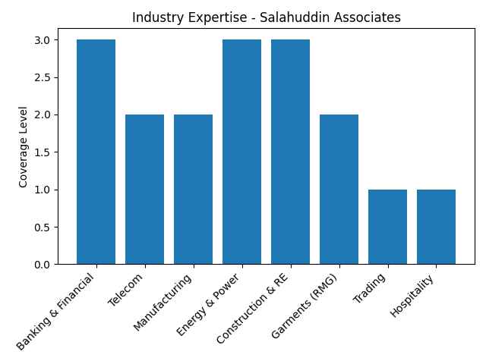
SALAHUDDIN ASSOCIATES
INDUSTRY EXPERTISE
Salahuddin Associates has successfully served clients across a wide range of industries, including:
  Banking and Financial Institutions
  Telecommunications
  Manufacturing and Industrial Sector
  Energy and Power
  Construction and Real Estate
  Garments and Textiles (RMG)
  Trading and Distribution
  Hospitality and Services

Slide 17
SALAHUDDIN ASSOCIATES
OUR EXPERTISE & IMPACT
  Filing of 1,000+ personal income tax returns annually with accuracy and full compliance.
  Handling tax filings for 100+ companies, including local businesses and foreign clients.
  Conducting paid, customized training programs tailored to client specific tax and compliance needs.
  Organizing regular in-house training sessions open to interested participants on taxation and regulatory updates.
  Providing certificates to participants upon successful completion of training programs.
  Delivering reliable, compliant, and scalable tax solutions while building long-term client relationships.

Slide 18


SALAHUDDIN ASSOCIATES
OUR CLIENTS
We proudly serve:
  Local SMEs and growing enterprises
  Multinational corporations (MNCs)
  Startups and emerging businesses
  Foreign investors and international entities

Slide 19
















SALAHUDDIN ASSOCIATES
SOME OF OUR HIGH PROFILED CLIENTS

Slide 20















SALAHUDDIN ASSOCIATES
SOME OF OUR HIGH PROFILED CLIENTS

Slide 21


SALAHUDDIN ASSOCIATES
WHY SALAHUDDIN ASSOCIATES ?
  Proven track record since 2013
  Big Four–trained leadership
  Deep understanding of Bangladesh regulatory framework
  Client-focused, solution-driven approach
  High-quality service at competitive cost

Slide 22







SALAHUDDIN ASSOCIATES
CONTACT US
+88 01727 153091
salahuddinassociates.com
salahuddinassociates2013@gmail.com
salahuddin2002@gmail.com
Salahuddin Associates
Salahuddin Associates
H-356, R-27, DOHS, Mohakhali, Dhaka, Bangladesh

